Slide 1

Power estimation GUI
Air

Slide 2
Purpose
Objective: this power estimation GUI (PE-GUI) is to facilitate Application Engineers and Design Engineers to input geometrical parameters and calculate the power needed for common pipe systems.
Note: common pipe systems are approximated as a combination of the following default components.
Pipes
VCRs
Filters
Air

Slide 3
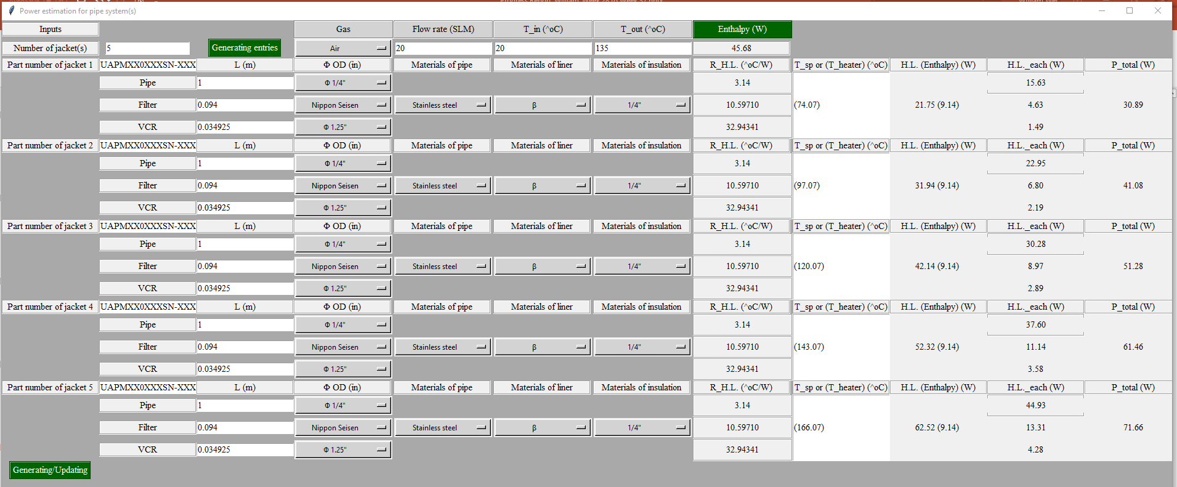
GUI overview
The GUI is designed and created using Python tkinter module.
Air

Slide 4
PE algorithm-enthalpy and heat loss
At steady state, Power input = Enthalpy (energy taken by fluid flow in the pipe) + Heat loss (energy escaping to anywhere except the fluid).
Heat loss
Fluid flow
Pipe
Power input
Inflow
Enthalpy
Outflow
Thermal insulation
Heating element
Cross-sectional view of a pipe/heater set

Slide 5
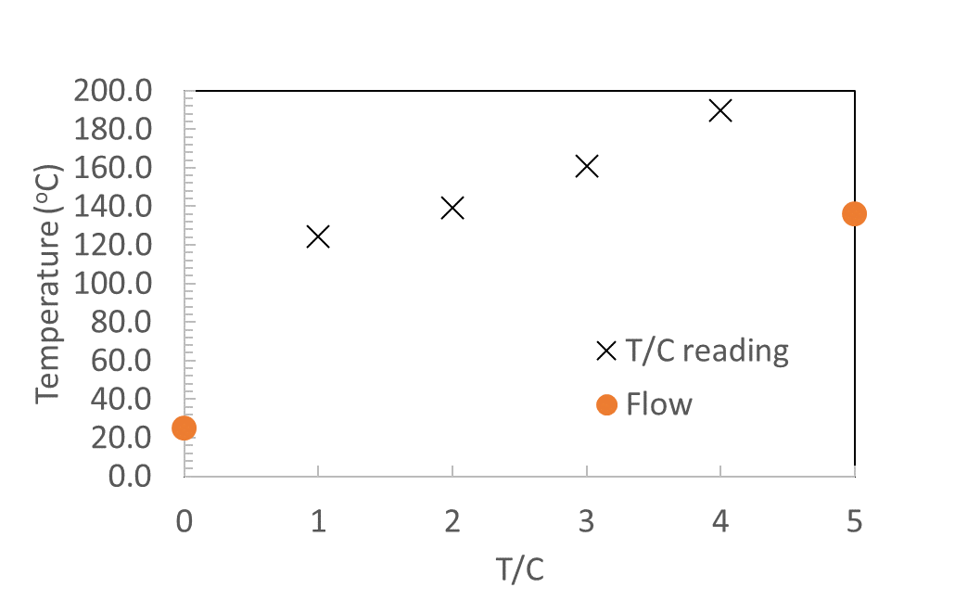
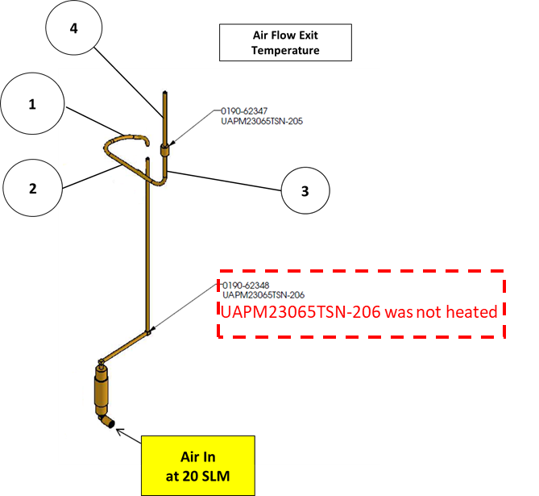
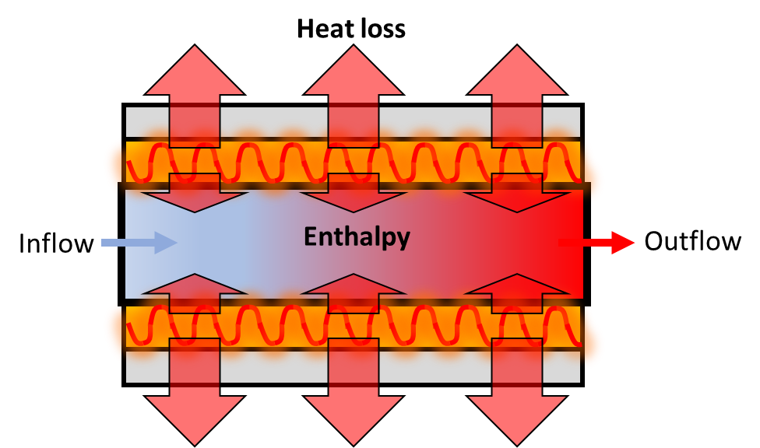
Enthalpy-energy carried by the flow
Enthalpy=density * specific heat (C_{p}) * volumetric flow rate * (T_out – T_in)
Enthalpy
T_in
T_out

Slide 6
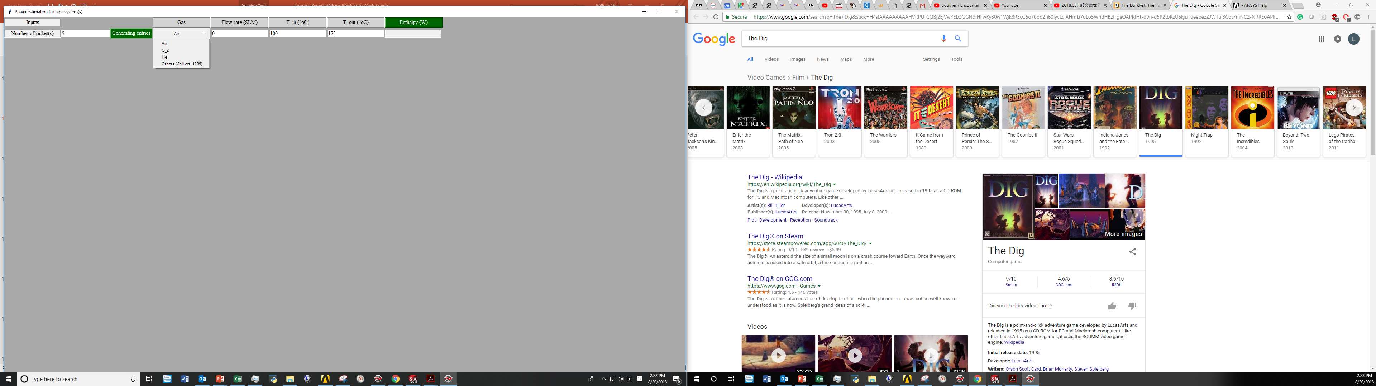
GUI - enthalpy
2
1
1
This is, by default, the input of the number of heating.
Air
2
After selecting gas type and entering flow rate/temperatures, clicking “Enthalpy (W)” button calculates the enthanlpy.

Slide 7
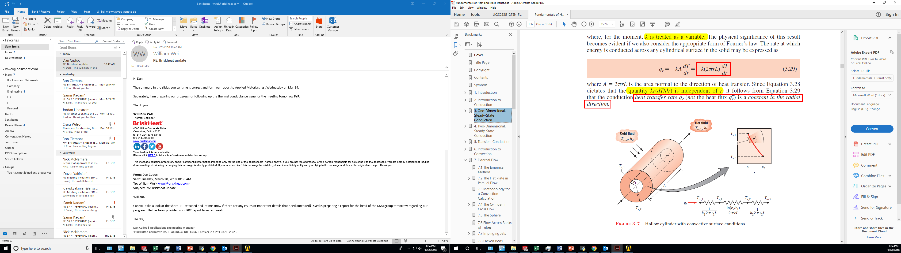
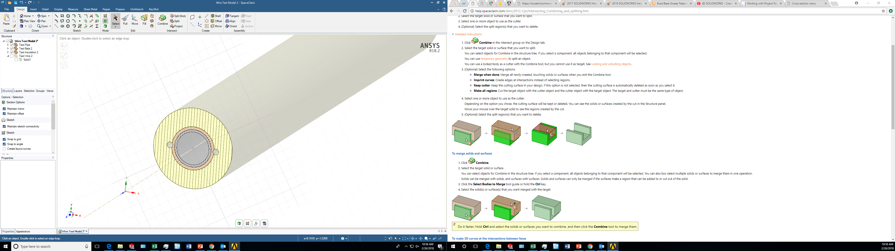
PE algorithm - Thermal circuit in radial direction
Thermal circuit in solids are functions of geometrical factors and properties of materials.
Pipe
Liner (Beta)
¼” Insulation
Bergman, Theodore L., Frank P. Incropera, David P. DeWitt, and Adrienne S. Lavine. Fundamentals of heat and mass transfer. John Wiley & Sons, 2011.

Slide 8

Thermal circuit in radial direction in Pipe/Liner/Insulation systems
Pipe/Liner/Insulation
Pipe
Liner (Beta)
Fluid
Ambient
Enthalpy
Heat loss
Forced convection
Pipe
Liner (Beta)
¼” Insulation
Natural convection
Heating source
¼” Insulation
Fluid
Ambient
Pipe
Liner (Beta)
¼” Insulation
Natural convection
Heating source (i.e., heating wire here)
Thermal resistance in each layer
Interface

Slide 9
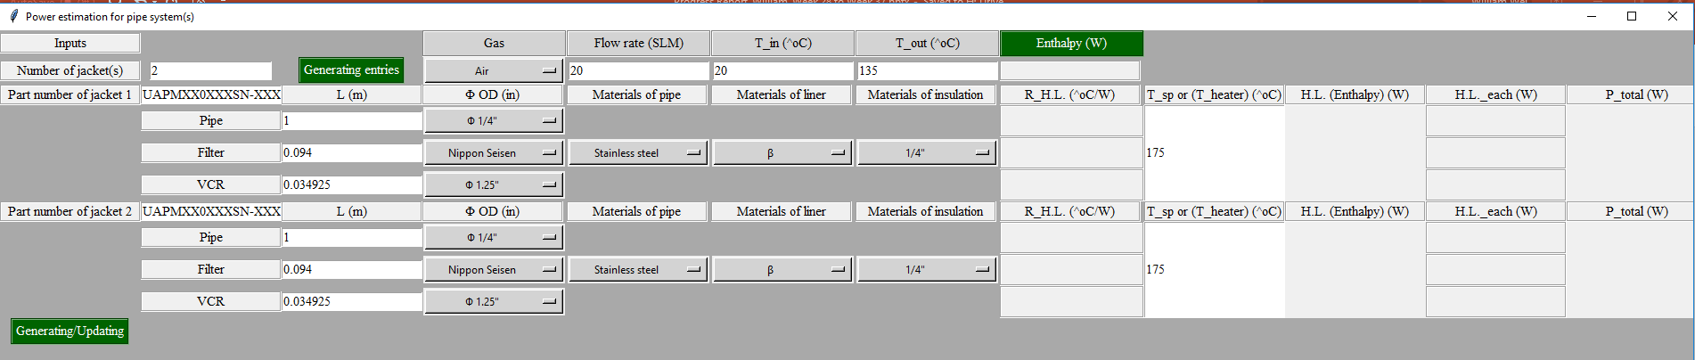
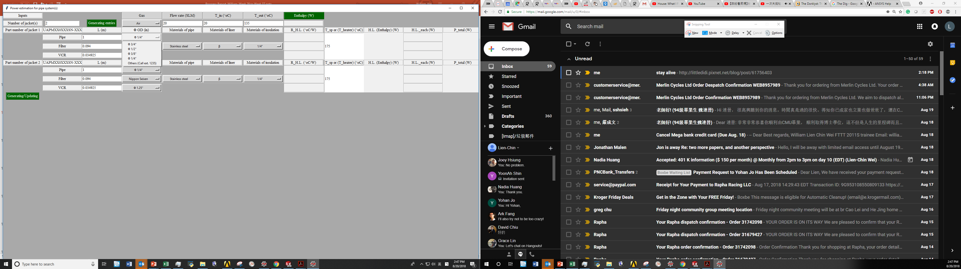
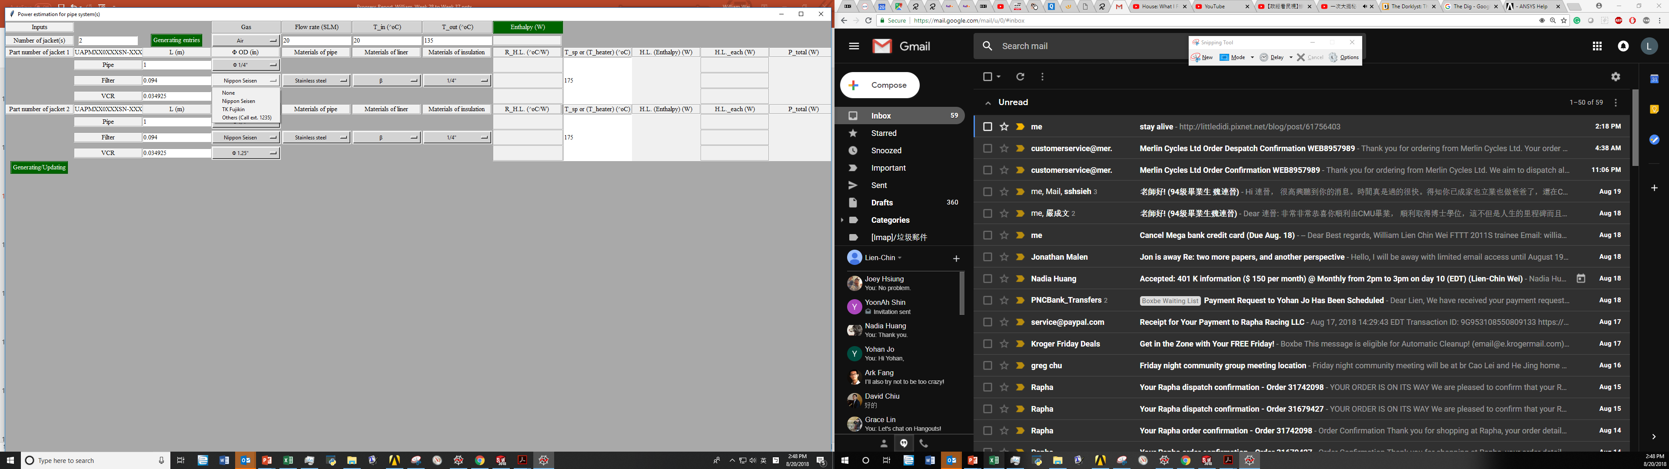

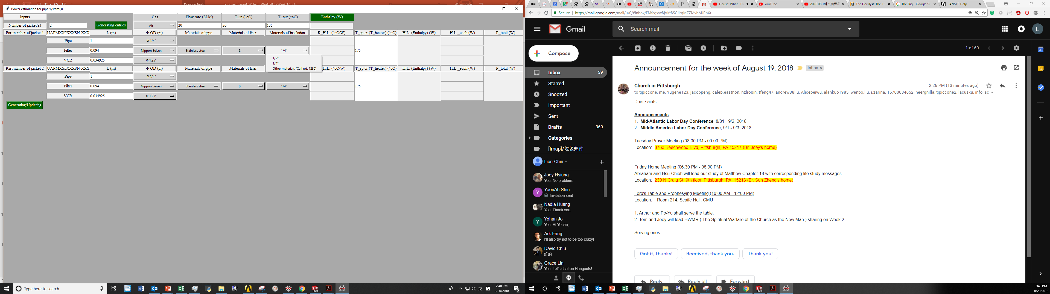
GUI – thermal resistance
0
1
2
3
Air
0
Entering the part number for each heater
Entering the length of pipe/fitler/VCR
1
Selecting pipe diameter, filter type, and VCR type
2
3
Selecting the materials for pipe/liner/insulation

Slide 10
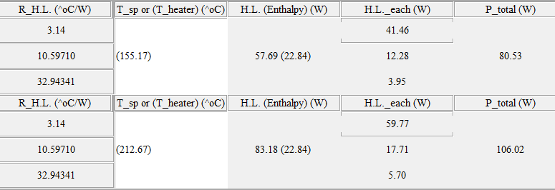
GUI – Power
1
2
Air
Entering the weldment surface temperature setpoint (T_sp) of pipe for no flow case (For flow case, T_heater is not input but calculated )
1
Clicking “Generating/Updating” button to generate
Thermal resistance (R_H.L.)
Heat loss (H.L.)
total power (P_total)
2

Slide 11
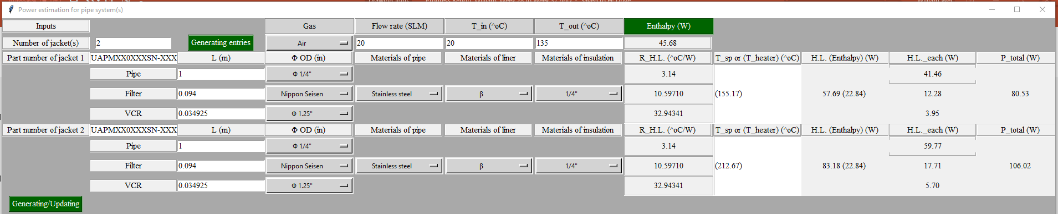
GUI power estimation
The select menu is expandable.
This GUI handles default geometry
Air

